Slide 1
GBT Project Report
Block-based Parallel Tree Building in GBT
Bo Peng
IPCC@Indiana University

Slide 2
Outline
The problem and basic ideas
Current results
Plan for next step

Slide 3
The Problem
Goal: Build a distributed version of GBT with DAAL GBT kernel and Harp communication library
Observations:
Based on the benchmark results analysis on xgboost and daalgbt, we found
xgboost has better memory efficiency, lower cpu utilization with too much spin time
daalgbt has better cpu utilization, memory bottleneck with high LLC miss
Problem
Why?
Can we get a better solution when combining the advantages from both?

Slide 4
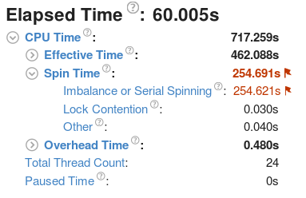
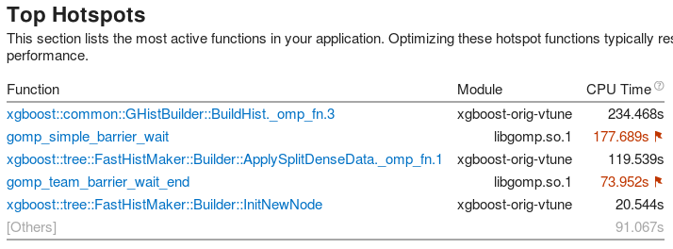
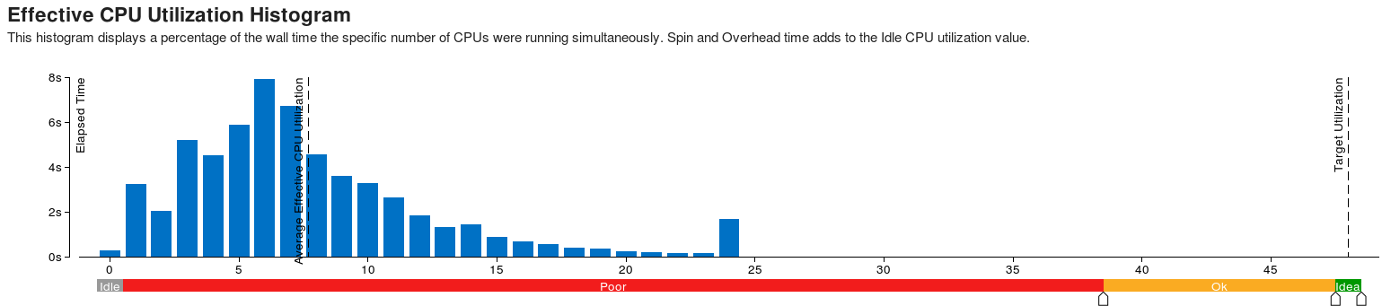
xgboost + Higgs + hist

Slide 5
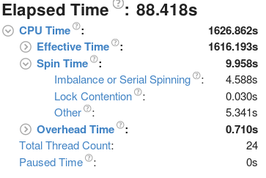
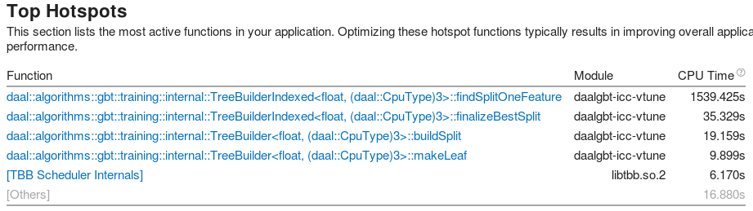
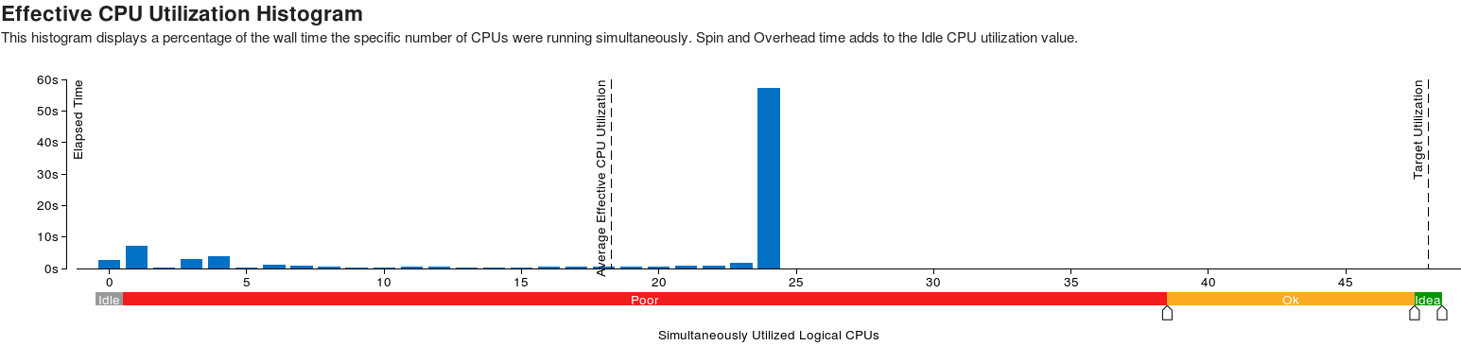
daalgbt-icc + Higgs + inexact

Slide 6
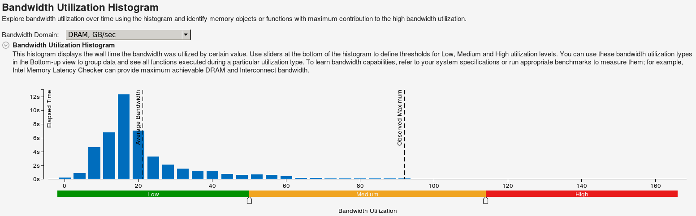
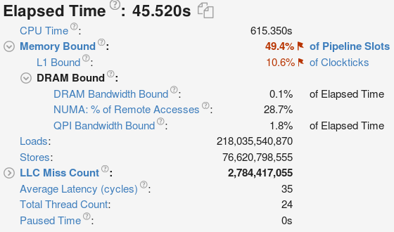

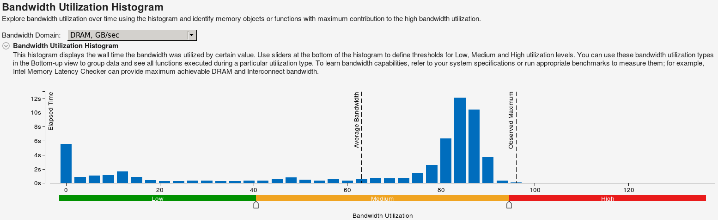
Higgs + Histogram
xgboost+ hist
daal + inexact

Slide 7
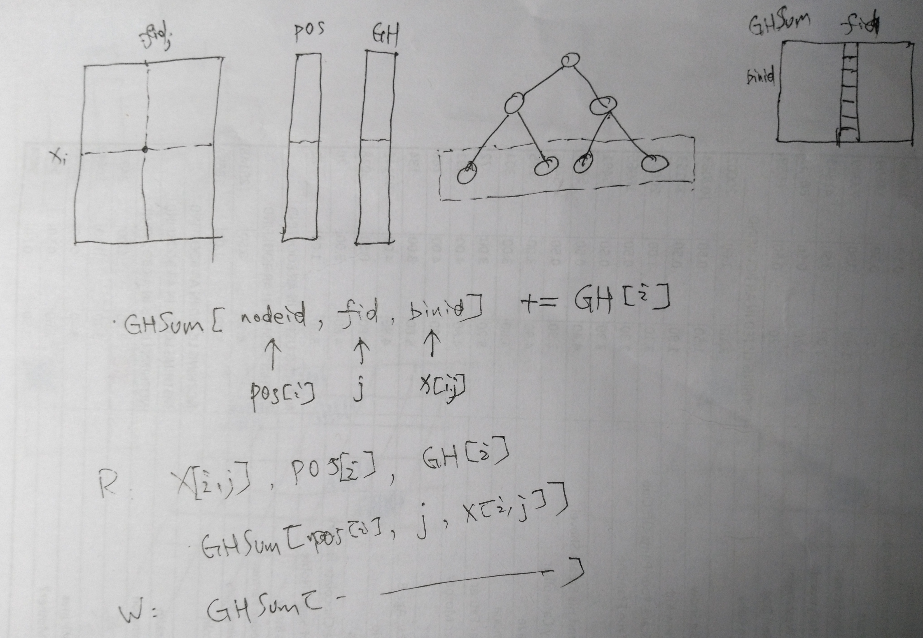

Slide 8
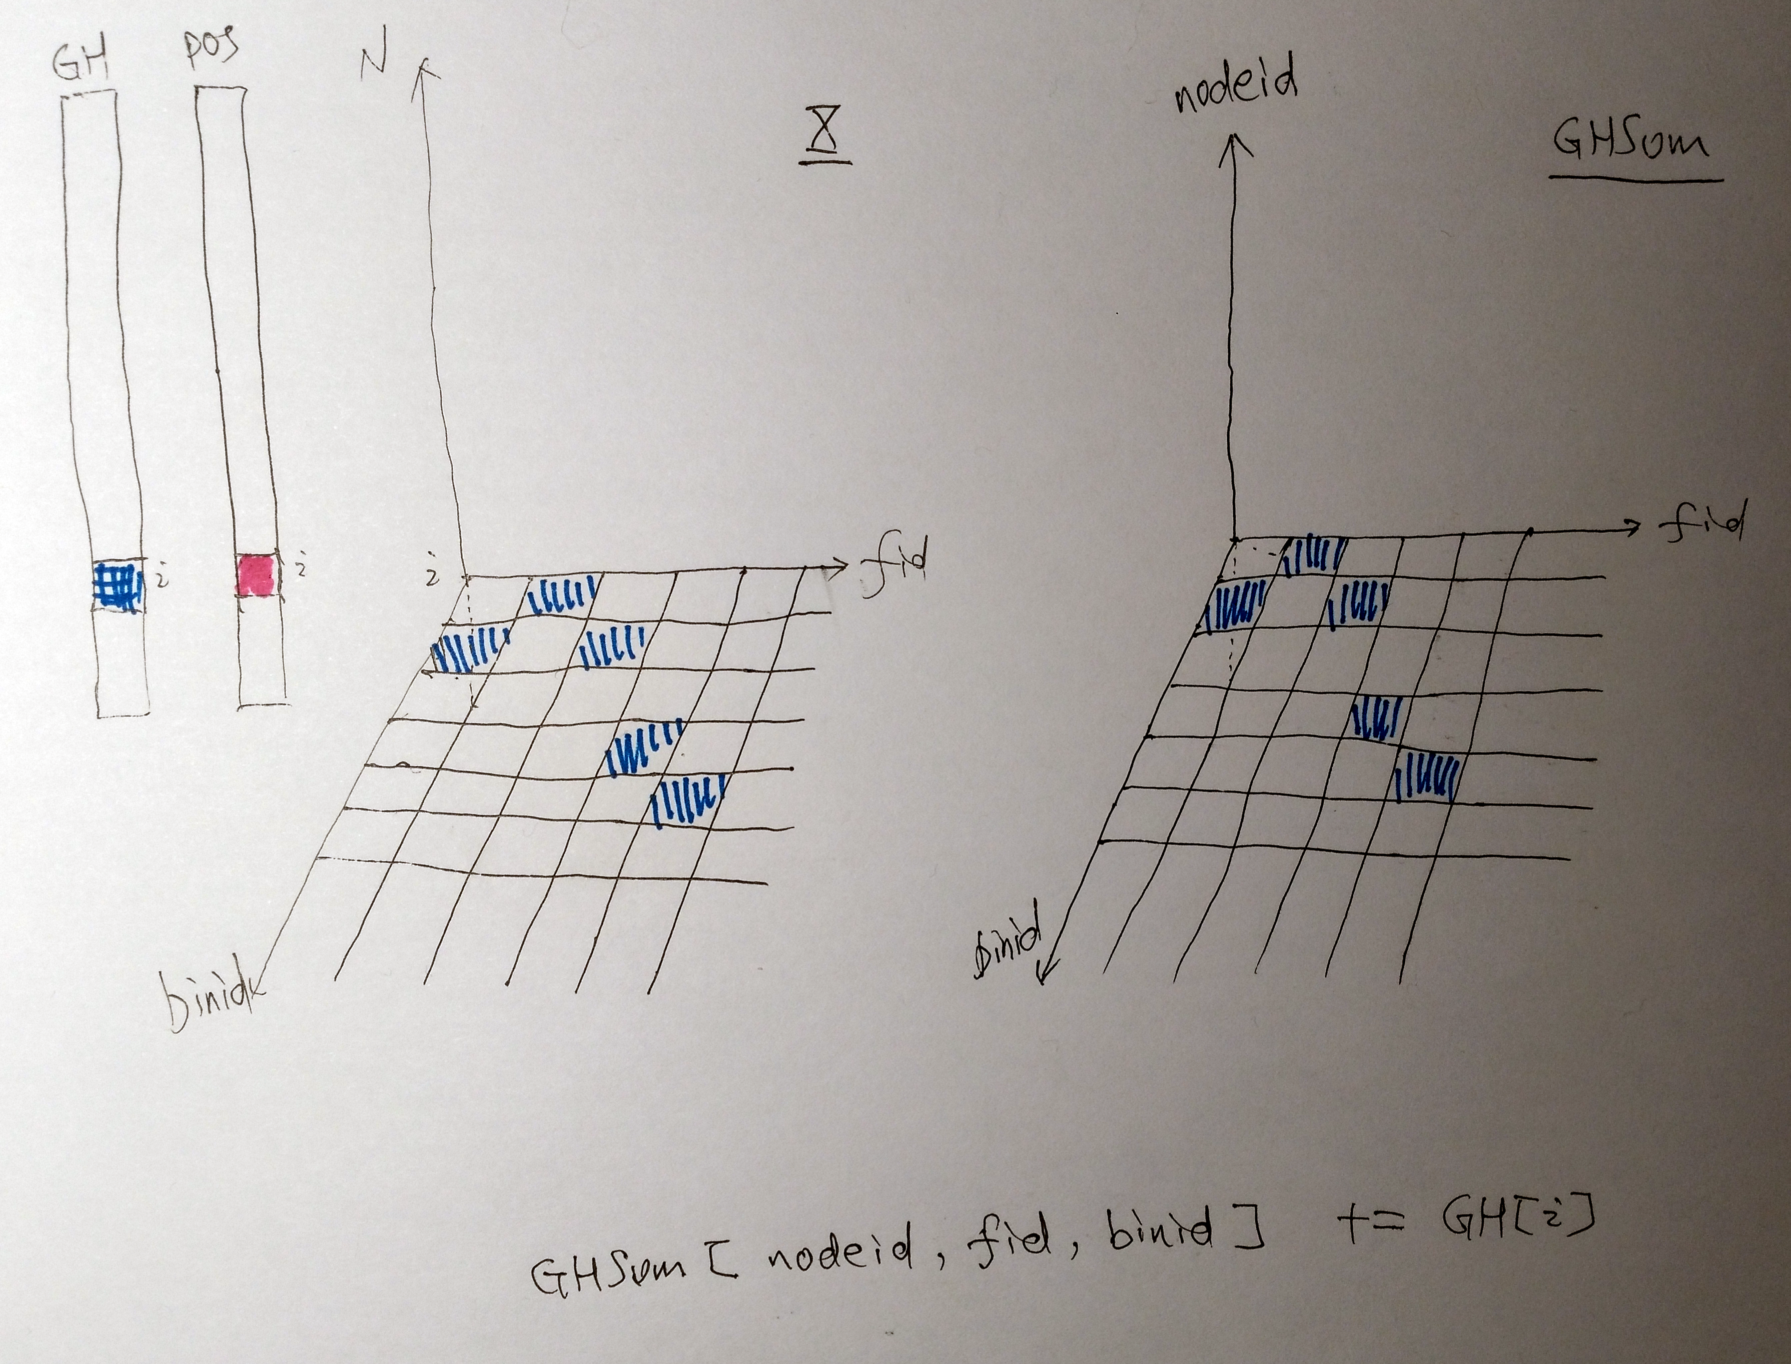
BuildHist

Slide 9
Basic Ideas - Compact Data Structure
Use binid instead of fvalue during the tree building
max_bins 256, 1 Byte compact for dense input
release the memory of the source input matrix

Slide 10
Basic Ideas- Parallelism Level
GHSum is a 3-D matrix, <nodeid, fid, binid> , all cells can be accessed in parallel without conflicts
popular approaches
maitain node rowset (aggregate the same nodeid togather in POS) to enable nodeid level parallelism
pros : improve access locality for write, good when node set shrinks
cons : overhead of the maintainance, small number in the beginning
feature-level parallelism
pros : widely adopted
cons : only one data in one example at most, not much cache friendly
new approach
binid level parallelism
pros : multiple data in one example, cache friendly
cons : sparse structure

Slide 11
Basic Ideas- Cache
Read
read continuously if possible
Write
make write operations in constrained small region if possible
sort by nodeid
sort by binid
sort by fid
trade-off between these two requirements
SimpleVersion: feature-level parallelism + column-wised continuous storage+ no sort of binid (keep rowid in order)
BlockVersion:

Slide 12
Basic Ideas- Vectorization
BuildHist is not computation intensive
indirect memory access
even scatter/gather vectorization seems to be infeasible here
hard to avoid conflicts in write
computation on GHSum can be vectorized
halftrick: GHSum_right = GHSum_parent - GHSum_left

Slide 13
SimpleVersion
Optimize xgboost Approx
feature-level parallelism
column-wised continuous storage
feature
global histogram, only initialize once
no sort of binid (keep rowid in order)
compact 1 Byte bindid for dense input
task scheduler: omp and tbb

Slide 14
Higgs Results (eta=0.1,iter=300,depth=6)
trainer | Parameter | training time(s) | BuildHist Time(s) | BuildPos Time(s) | AUC
xgb | Approx | 1354.1 |  |  | 0.742
xgb | Hist | 232.4 | 52.1 | 86.8 | 0.742
daal-icc | Inexact | 402.7 |  |  | 0.742
simple | pmatfast | 183.8 | 129.8 | 35.7 | 0.741

Slide 15
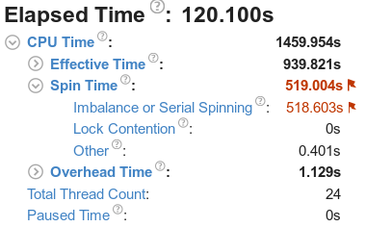
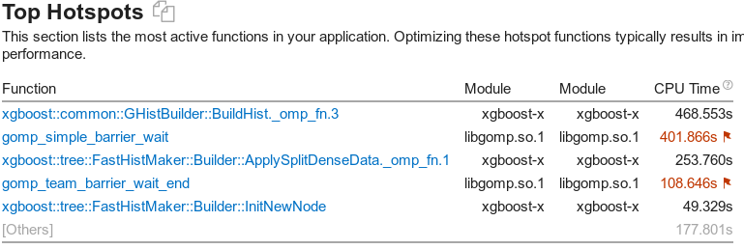
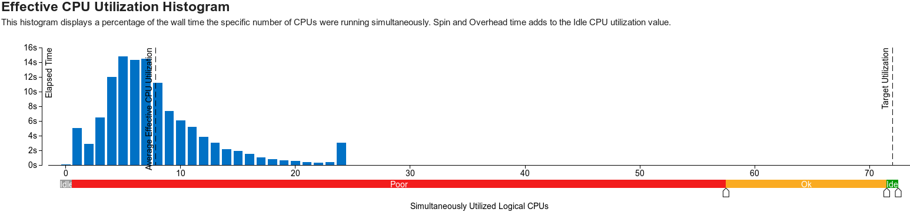
xgboost + Higgs + Hist

Slide 16
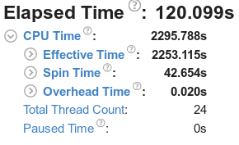
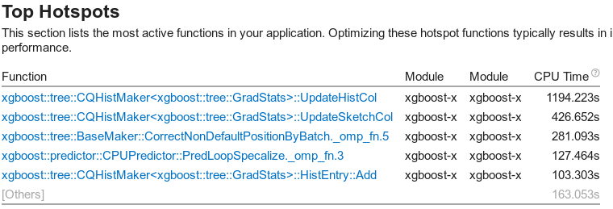
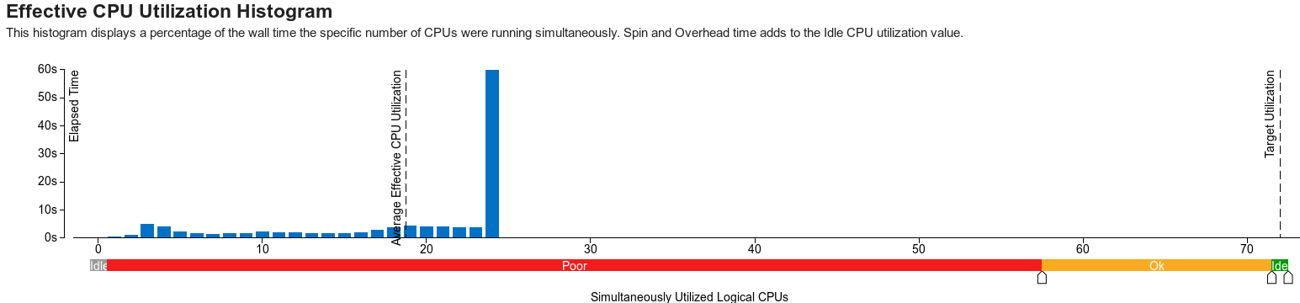
xgboost + Higgs + Approx

Slide 17
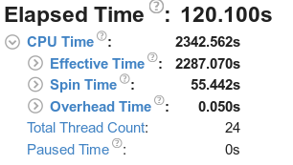
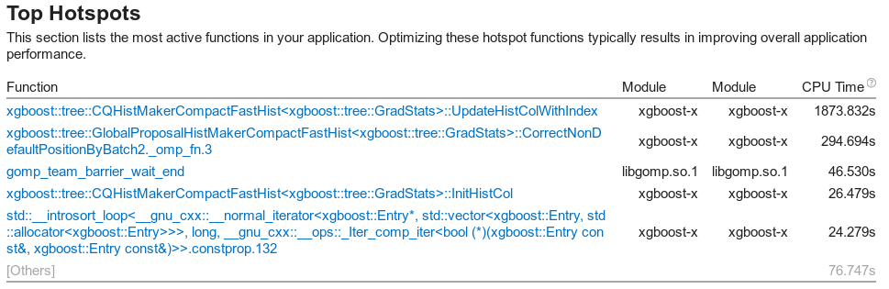
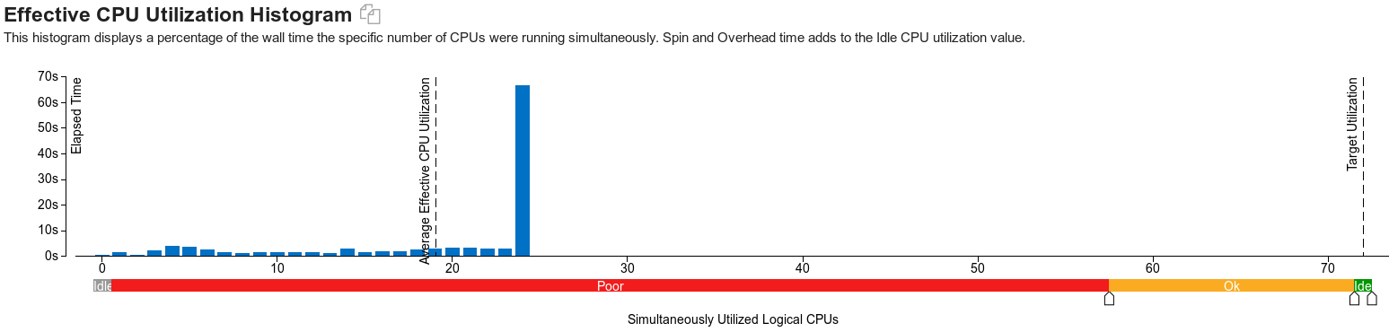
xgboost + Higgs + fullcompact

Slide 18
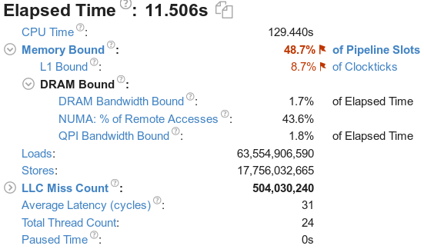
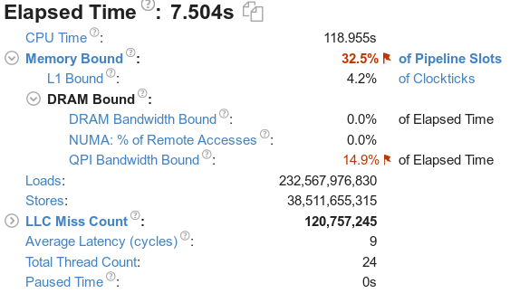
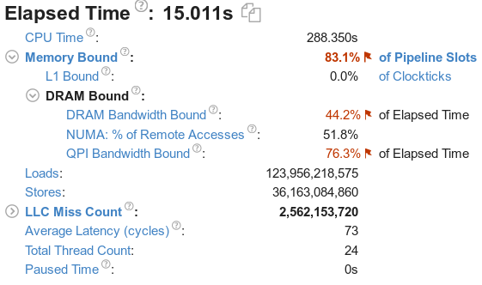
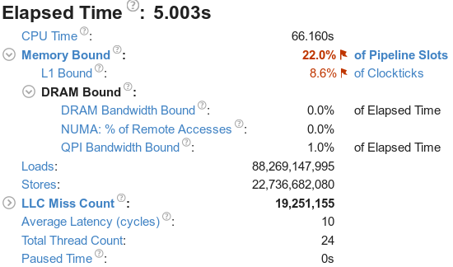
Higgs Memory-access
xgboost+ hist
xgboost+pmatfast
daal + inexact
xgboost+pmatfast+halftrick

Slide 19
Future Plan
continue on BlockVersion
Sampling Algorithm
add approximation to get the statistics of GHSum
similiar to Histogram, using partial examples is possible to get enough accurate GHSum, the sampling algorithm should be important
Distributed version
BlockVersion + Sampling + Harp CollectiveCommunication(rotation)

Slide 20
Q&A

Slide 21
Configuration
machine
CPU: Intel(R) Xeon(R) CPU E5-2670 v3 @ 2.30GHz
Cores: 2 Sockets x12 cores each = 24 Cores (thread# set to 24)
RAM: 128 GB
Compiler
gcc (crosstool-NG fa8859cb) 7.2.0
icc (ICC) 19.0.0.117 20180804

Slide 22
Dataset
dataset | train# | test# | features# | sparsity | size
synset | 750K | 250K | 50 | dense | 420 MB
 | x5,x10 |  | x2,x4 |  | 17 GB ~40 times
airline | 1m | 100K | 690 | dense(one-hot encoding) | 2.6 GB/63 MB
higgs | 10m | 1m | 28 | dense | 4.8 GB

Slide 23
Higgs Results
dataset | trainer | Parameter | training time(s) | AUC
higgs | xgb | Exact | 1387.3 | 0.742
 |  | Approx | 1354.1 | 0.742
 |  | Hist | 229.7 | 0.742
 | daal-gnu | Exact | 776.5 | 0.742
 |  | Inexact | 494.6 | 0.742
 |  | Exact + memSave | 3686.3 | 0.710
 |  | Inexact + memSave | 3669.1 | 0.712
 | daal-icc | Exact | 653.0 | 0.742
 |  | Inexact | 402.7 | 0.742
 |  | Exact + memSave | 3550.0 | 0.715
 |  | Inexact + memSave | 3564.8 | 0.712

